Slide 1


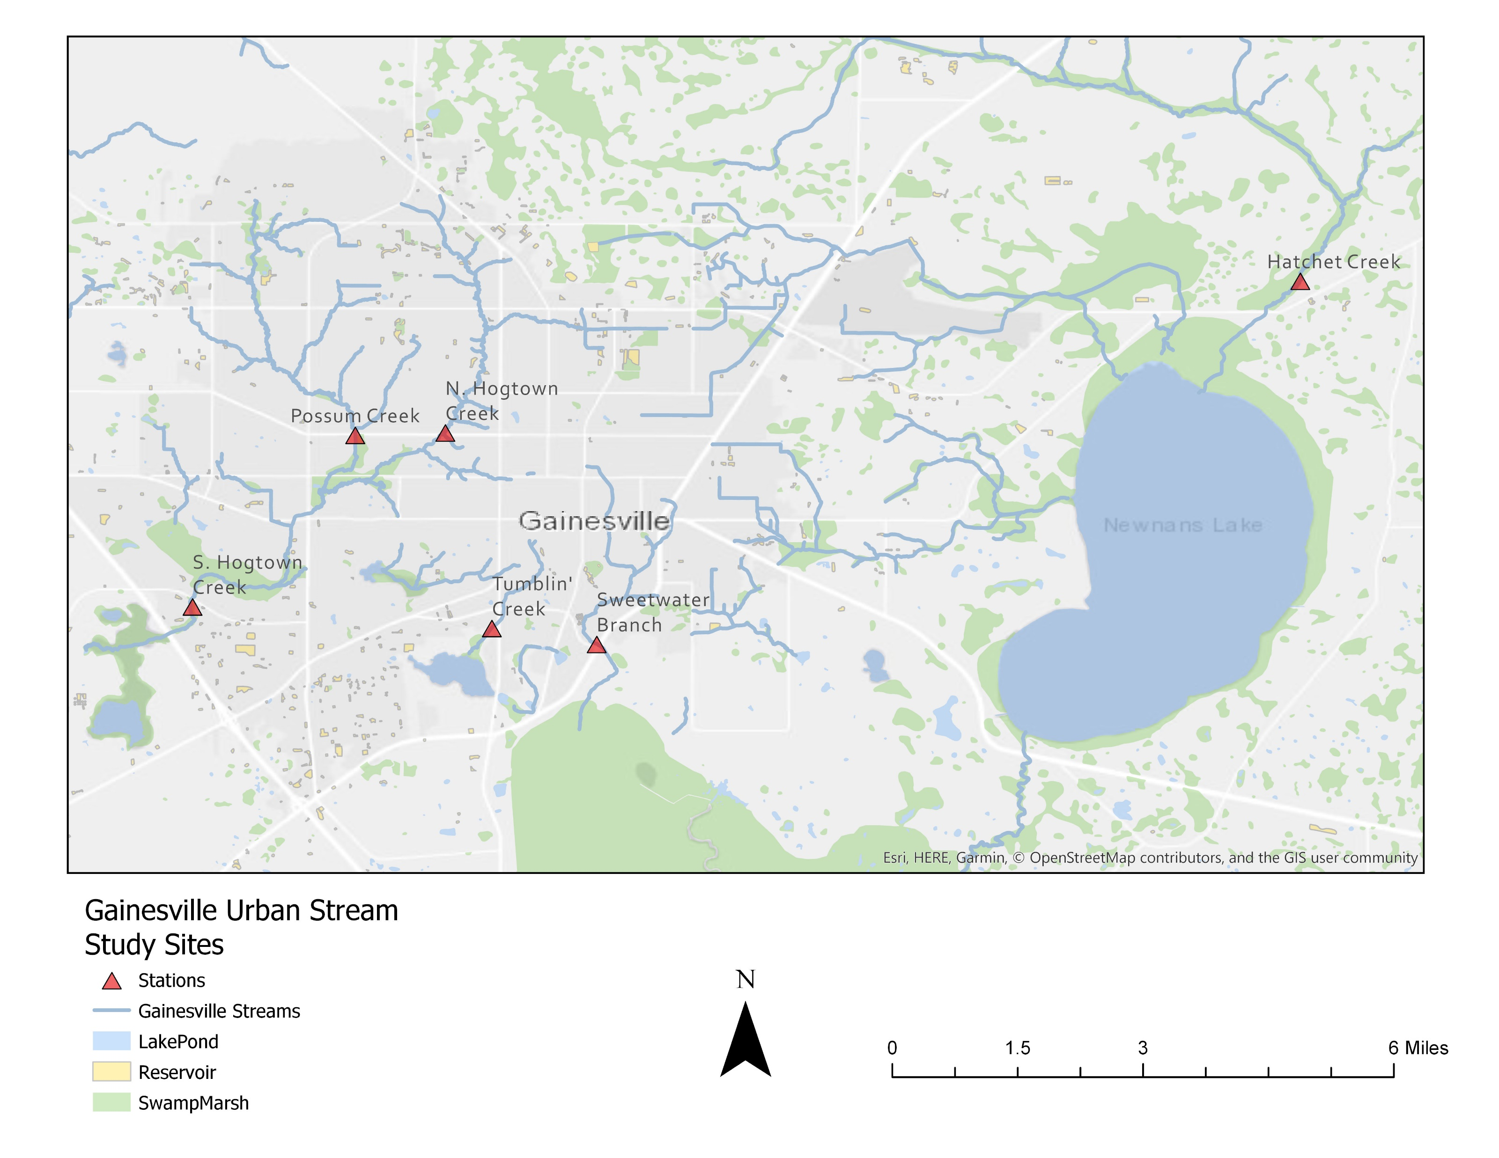
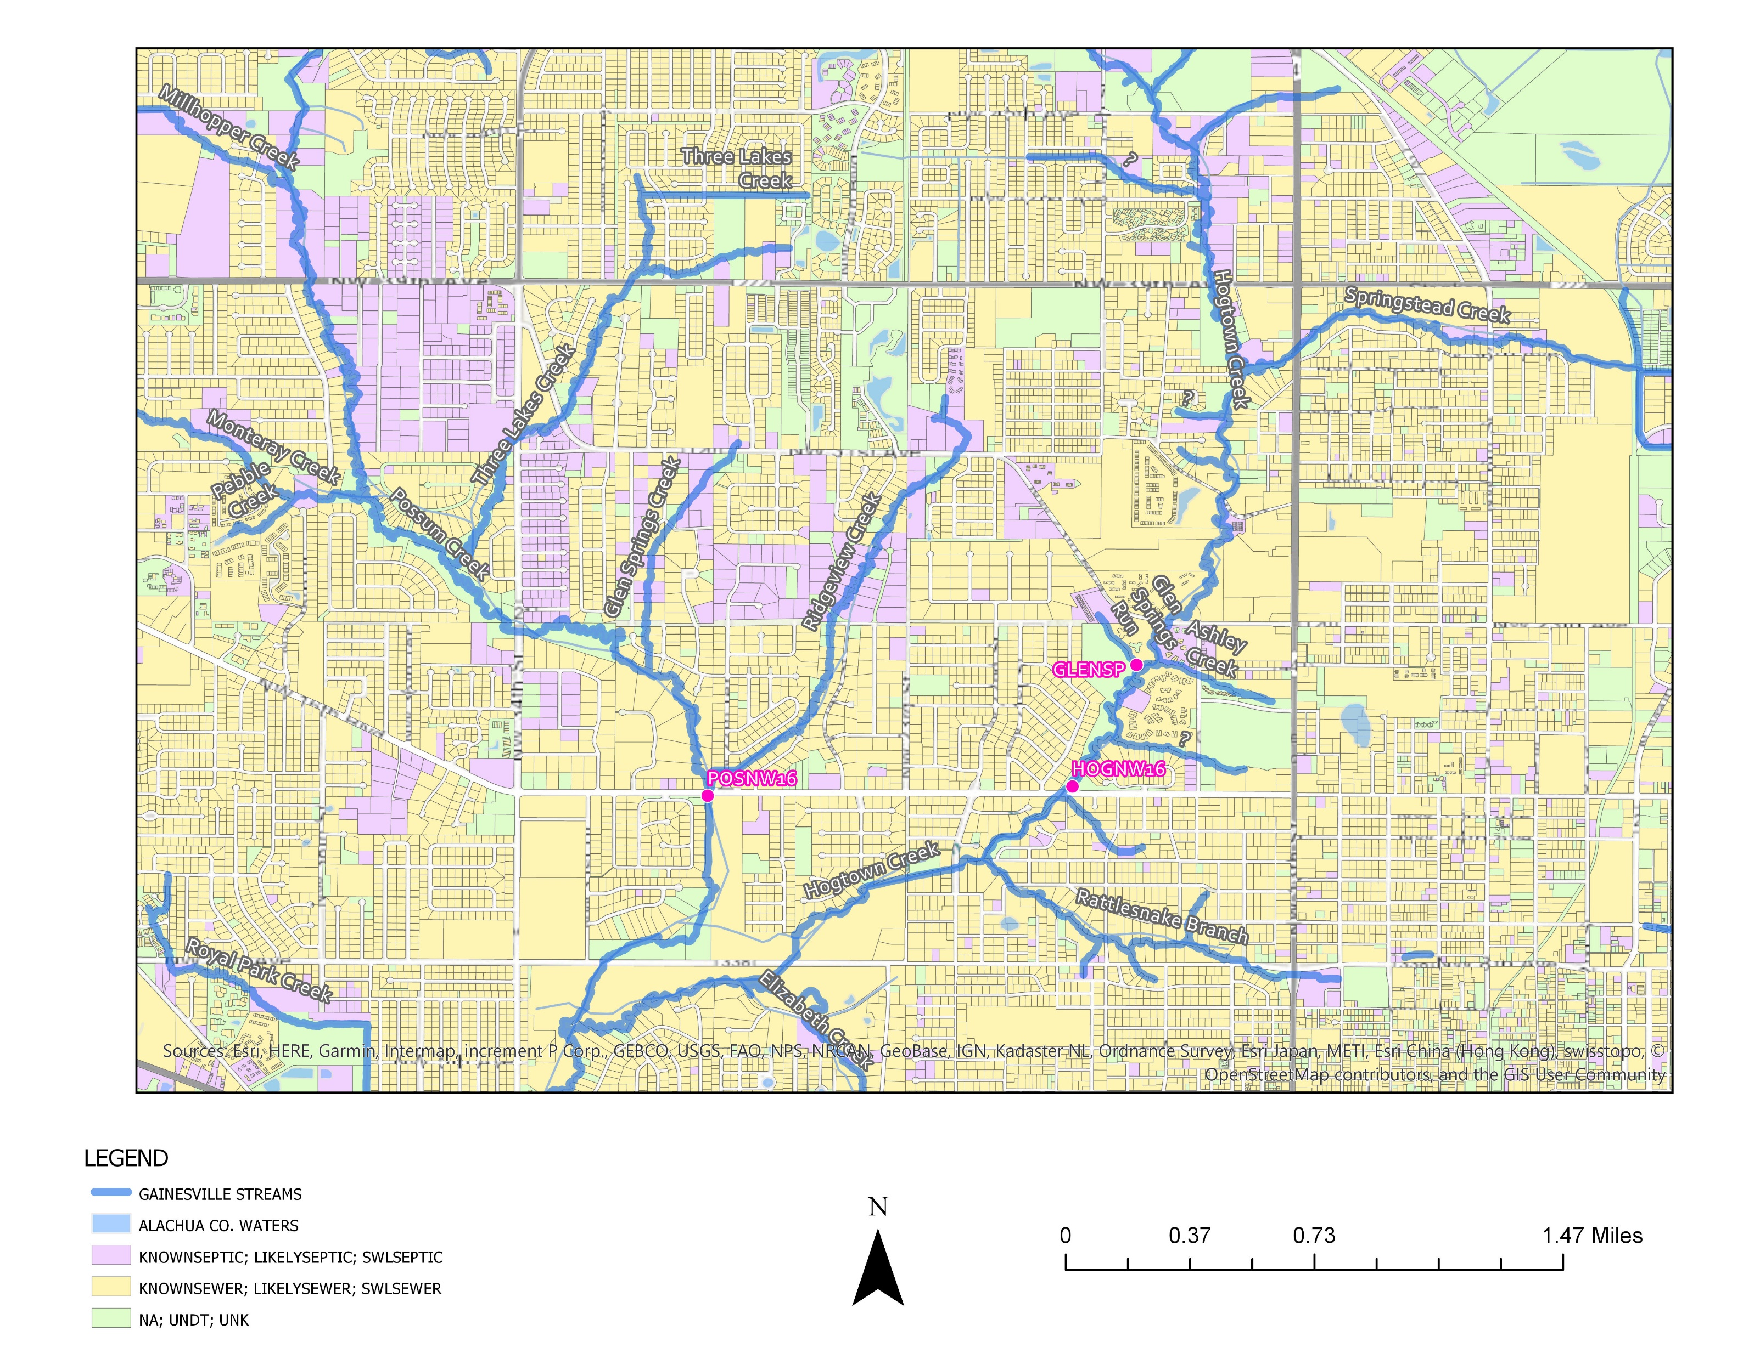
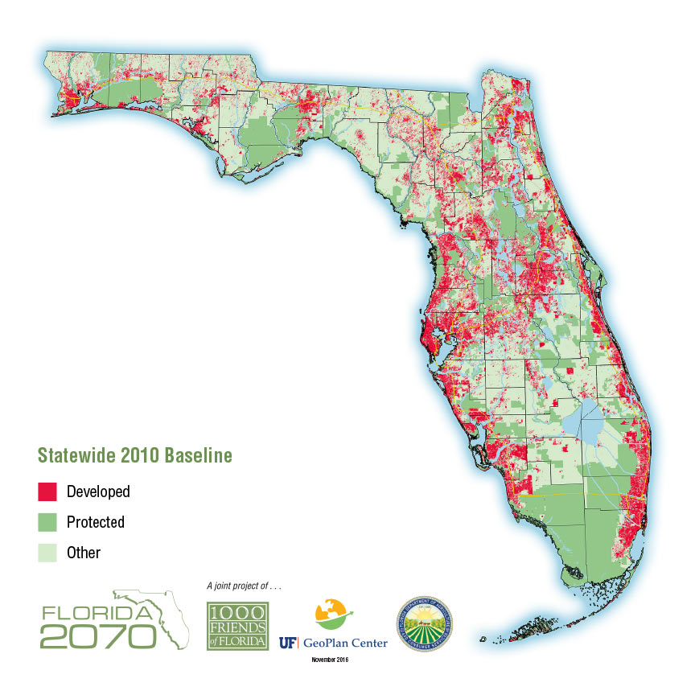
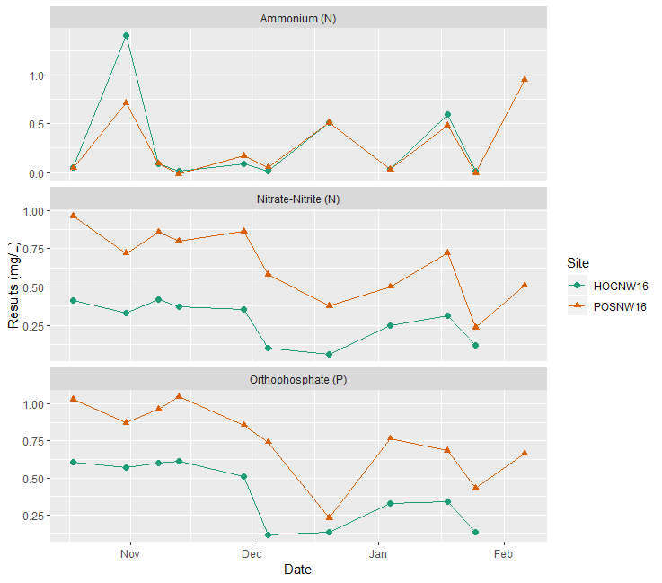
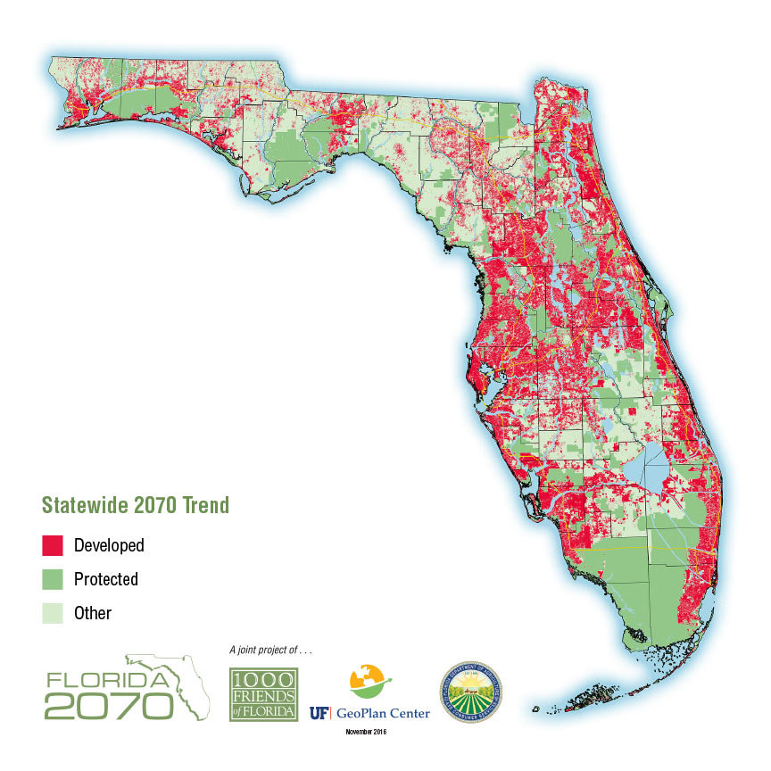
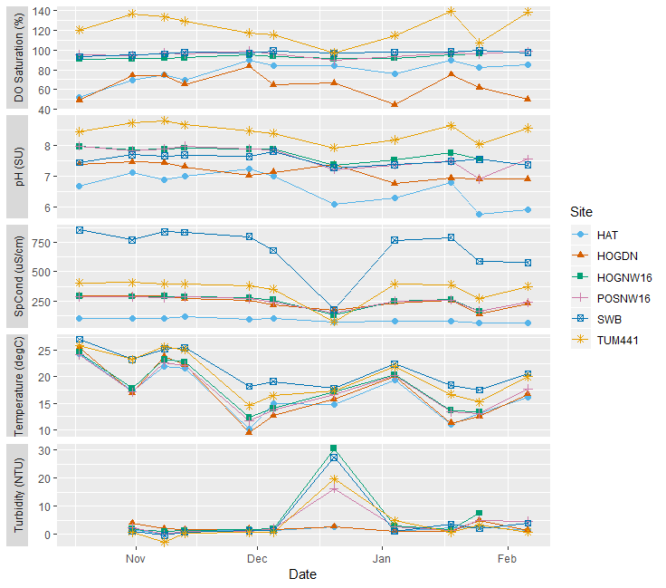
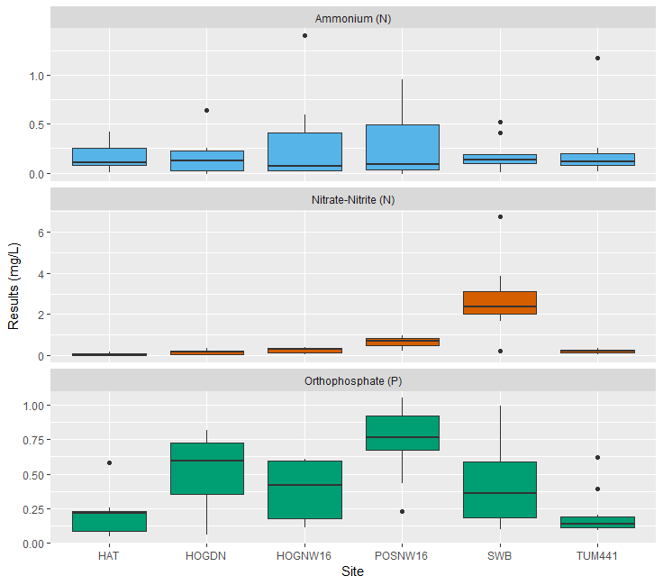
Landscape Patterns Drive Variability In Water Chemistry Across Sub-tropical Urban Streams
Emily Taylor and Alexander J. Reisinger
Soil and Water Sciences Department, University of Florida
INTRODUCTION
STUDY SITES
RESULTS
With global populations rising and more people moving into densely populated urban areas, anthropogenic pressures on urban ecosystems will continue to rise. Increasing pressures from various types of urban development alter the hydrology and water chemistry in urban streams. These pressures include alterations in land cover (i.e., increases in impervious surface cover), chemical inputs (i.e., fertilizer and wastewater inputs), and biological changes (i.e., reductions in biodiversity). Quantifying how urban ecosystems respond to these various pressures will assist in better management and development of cities. While research regarding the energy and nutrient dynamics in urban streams has grown considerably, there is still much to be understood with respect to the long-term effects of stream geomorphology (i.e., streambed structure) and surrounding landscape practices on stream nutrient and energy dynamics.
Over 90% of Floridians currently reside in urban areas and that density is expected to grow along with a rapid increase in population through 2070. As these increases in population and subsequent ecosystem pressures are already occurring in several cities in Florida, understanding water quality dynamics of already urbanized streams in Florida provide an excellent opportunity to begin a long-term research program. Through regular water quality monitoring of six streams in Gainesville, FL, spanning a landscape gradient encompassing variability in land-use, stream bed compositions, and nutrient input sources, we hope to gain a broader understanding of how urban landscapes shape nutrient fluxes in urban streams.
Figure 2. Study sites include six streams located in Gainesville, FL. These streams span a landscape gradient encompassing variability in land-use, stream bed compositions, and nutrient input sources. Additionally, these sites correspond with existing water quality and discharge gauging stations that are monitoring by either the Alachua County Environmental Protection Department or the St. Johns Water Management District.
Another interesting trend that can be seen in the preliminary data are the slightly higher nutrient concentrations in two adjacent residential streams. Based off of the surrounding land use’s septic/sewer usage, there is some evidence that the increased density of septic systems in Possum Creek’s upstream waters could be a contributing factor to the higher concentrations.
Figure 5. Surveyed sewer or septic systems for the contributing waters of Hogtown Creek and Possum Creek (FDOH, 2018).
METHODS
Bi-weekly sampling of water quality field parameters using a YSI Pro-DSS include:
Temperature (ºC),
Dissolved Oxygen (mg/L and percent saturation),
Specific Conductance (uS/cm),
pH (SU),
and Turbidity (NTU).
Additionally, triplicate water quality samples were collected and filtered in the field to be later analyzed for
Nitrate-Nitrite as N (mg/L),
Ortho-Phosphate as P (mg/L),
and Ammonium as N (mg/L).
These samples were analyzed using a Seal AQ 400 Discrete Analyzer
RESULTS
Figure 6. Highlighting the difference in nutrient concentrations in Hogtown and Possum Creeks.
Figure 3. Initial results from the field parameters begin to highlight the variability across landscapes. TUM441 is a concrete-lined channel which regularly exhibits the highest concentrations of dissolved oxygen and pH. SWB is a stream directly downstream from the cities Main Street WWTP and receives effluent discharge as evidenced by the high specific conductivity readings.
What can also clearly be seen in this figure is the dramatic decline in specific conductivity and increase in turbidity following a rain event in late December 2018.
CONCLUSIONS AND FUTURE RESEARCH
Figure 1. Florida’s projected population growth from 2010 to 2070 based on current growth trends (Carr & Zwick, 2016).
While too early to draw any major conclusions regarding long-term trends, some unique patterns have begun to arise. Future research will include an installation of continuous dissolved oxygen sensors which will be used to monitoring the stream’s metabolism. Additionally, dissolved organic matter will be sampled for to track potential sources and quality of carbon available in the various streams. A detailed analysis of the watersheds and their surrounding land use, impervious surface cover, population density, and stormwater infrastructure will also be conducted. This analysis will be used to help guide and track the potential causes of variability in these urban streams.
HYPOTHESIS & OBJECTIVES
Through regular water quality monitoring of six streams in Gainesville, FL, spanning a landscape gradient encompassing variability in land-use, stream bed compositions, and nutrient input sources, we hope to:
gain a broader understanding of how urban landscapes shape nutrient fluxes in urban streams,
capture any short- and long-term effects of the variety of stormwater, land, and wastewater management strategies being employed in our study region,
provide information on landscape practices affecting water quality in urban streams,
and facilitate the development of alternative strategies to minimize the impact of urbanization on downstream water quality.
We hypothesize that streams with more urbanized watersheds will exhibit both higher mean nutrient concentrations as well as greater temporal variability due to changes in hydrology and nutrient sources.
REFERENCES
Carr, M. H., and Paul D. Zwick. "Florida 2070: mapping Florida’s future—alternative patterns of development in 2070." Gainesville: University of Florida Geoplan Center (2016).
Placeholder for FDOH
Figure 4. Average concentrations of nutrients across the urban landscape gradient taken from October 2018 to February 2019. Preliminary results show a high variability across sites. Interestingly, our most urbanized site, TUM441, has some of the lowest and most stable nutrient concentrations.
NATURAL
RESIDENTIAL
DEVELOPED

